Slide 1
Denial of Service using HTTP Flood

Slide 2
Introduction
A denial-of-service (DoS) attack is a type of cyber attack in which a malicious actor aims to render a computer or other device unavailable to its intended users by interrupting the device's normal functioning. DoS attacks typically function by overwhelming or flooding a targeted machine with requests until normal traffic is unable to be processed, resulting in denial-of-service to addition users.

Slide 3
Aim of the Experiment
Create a server that serves a webpage.
Create a Legitimate user and access the webpage
Create 5 attackers.
Use Complicated PDU to attack the server.
Now when we try to repeat step 1 the server denies service to the legitimate user because it is busy servicing the attackers, thereby creating a denial of service.

Slide 4
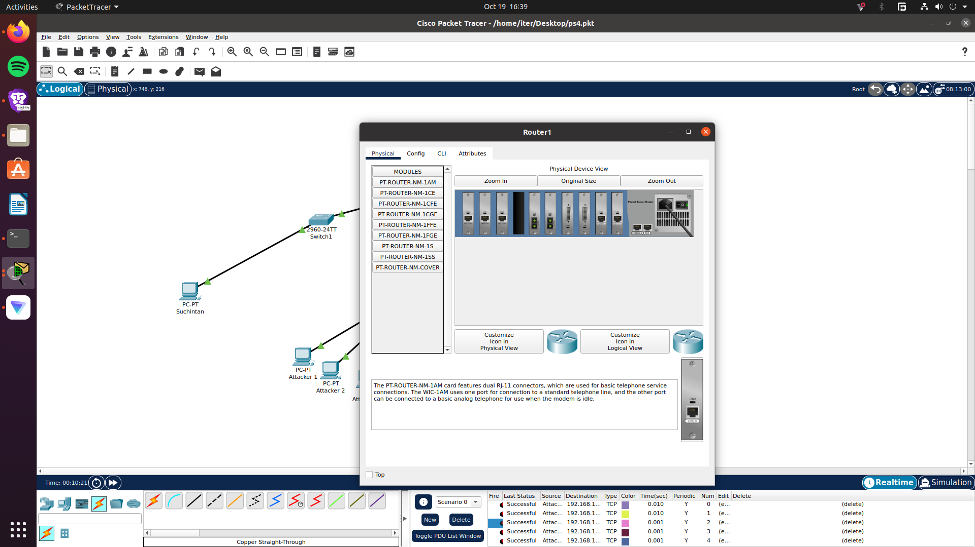
Create the network
Add a PT-Router and configure the router.
Add 3 Gigabit ethernet ports to the router.
These will be named
GigabitEthernet 7/0
GigabitEthernet 8/0
GigabitEthernet 9/0

Slide 5
Create the network
4. Configure the 3 new GigabitEthernet ports
5. Add 3 2960-24TT switches name them switch0 and switch1 and switch2.
4.Use Copper Straight through cable to connect switch0 to router
Connect gigabitethernet 8/0 of router to gigabitethernet 1/0 of switch0
Connect gigabitethernet 9/0 of router to gigabitethernet 1/0 of switch1
Connect gigabitethernet 7/0 of router to gigabitethernet 1/0 of switch2
GigabitEthernet 7/0 | GigabitEthernet 8/0 | GigabitEthernet 9/0
IPV4- 192.168.30.1 | IPV4-192.168.10.1 | IPV4-192.168.20.1

Slide 6
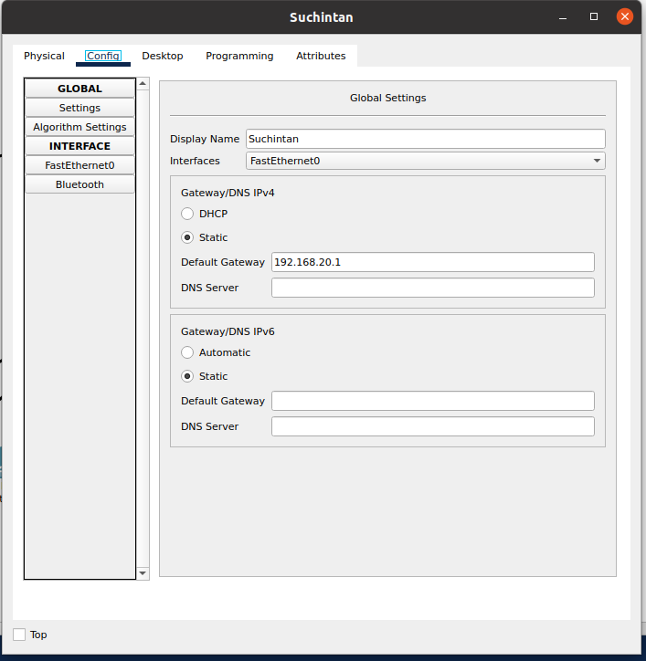
5. Add a PC to the network, connect the PC to Switch 1 using copper straight through cable to the fast ethernet port.
6. Configure the IP address of the PC as 192.168.20.1

Slide 7
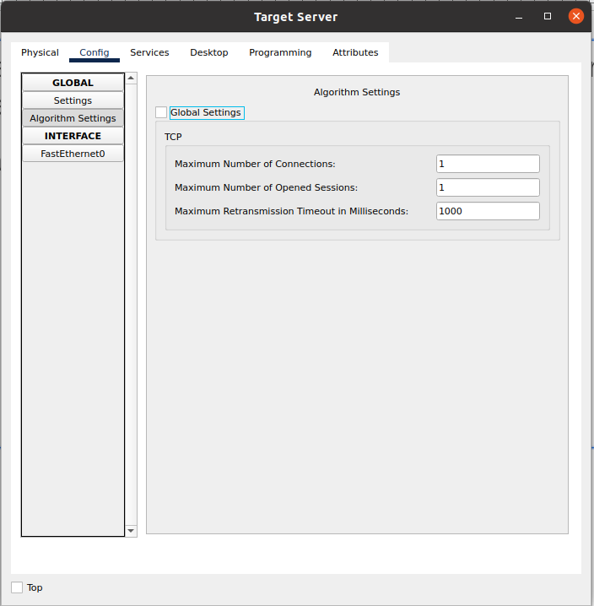
7. Add a server-PT to the network and attach it to switch0 using copper straight through cable to the fastethernet ports of each.
8. Configure the server and in default gateway field type the following IP address 192.168.10.1
9. Change the service rate settings as shown in the figure below

Slide 8
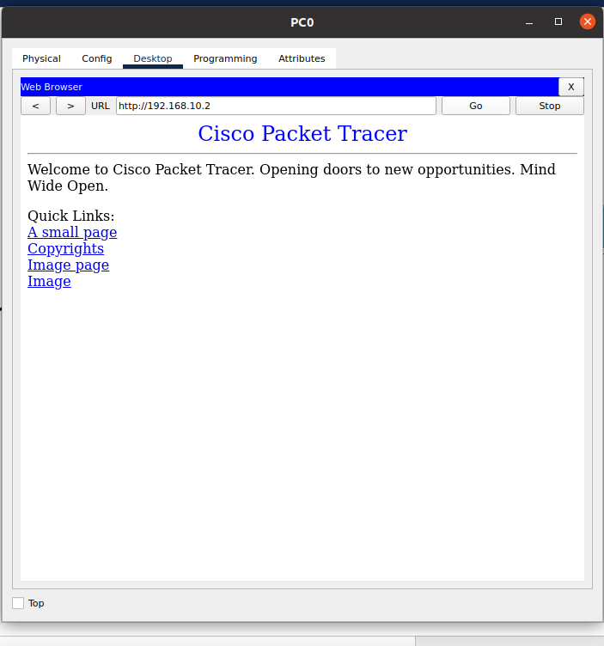
9. Click on the users PC and go to the desktop, click the browser option and try to access the server web page by typing the IP address of the server it should open the cisco webpage on the server. This shows the service is on and there is no DOS.

Slide 9
10. Add 5 PCs (rename them Attacker1 to Attacker5)to the switch2 using copper straight through cable to the fastethernet port.
11. Configure the IP address of the PCS as follows
FastEthernet IPV4
Attacker 1 | Attacker 2 | Attacker 3 | Attacker 4 | Attacker 5
192.168.30.2 | 192.168.30.3 | 192.168.30.4 | 192.168.30.5 | 192.168.30.6

Slide 10
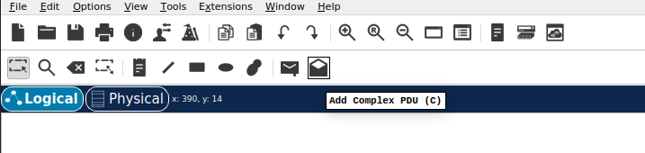
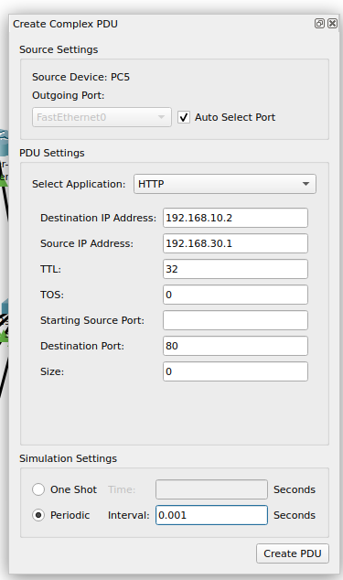
12. Configure a complex PDU for Attacker 1
13. Configure a complex PDU for Attacker 1 with HTTP protocol where the destination IP address is that of the target server.

Slide 11
14. Repeat Step 13 for all the attackers
15. Wait for 5 minutes
16. Click on the User PC and open the desktop tab, from the desktop tab open the browser try to access the server webpage. Is it denied?
17. Try to ping from the the user to the server, is it taking longer?

